Slide 1
Basic Motion, Velocity and Acceleration

Slide 2
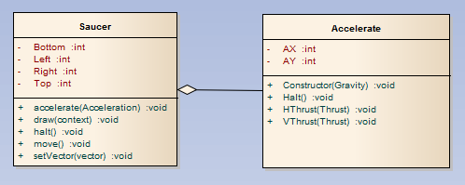
Example Classes

Slide 3



Saucer class
Private X and Y coordinates
Modified using the move() method
Modified using the accelerate() method

Slide 4
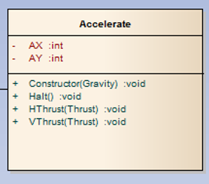

Accelerate class
Specify gravity in the constructor
May be used to apply thrust, thus increasing the values of x and y for the saucer

Slide 5

Velocity and Acceleration
Velocity = the speed of an object
Acceleration = the increase in speed of an object
That is acceleration changes the value of VX and VY such that the speed of the object changes

Slide 6
Gravity
The attraction between bodies
The planet Earth exerts a gravitational pull on the Moon; the Moon exerts a pull on the Earth
From the point of view of standing on the Earth gravity is mostly about falling
The effect of gravity is that it is incremental

Slide 7
Finally
Work through the work sheet for this session, there are practical example
Again the computer handles the calculations
Appreciation is still important

